Slide 1
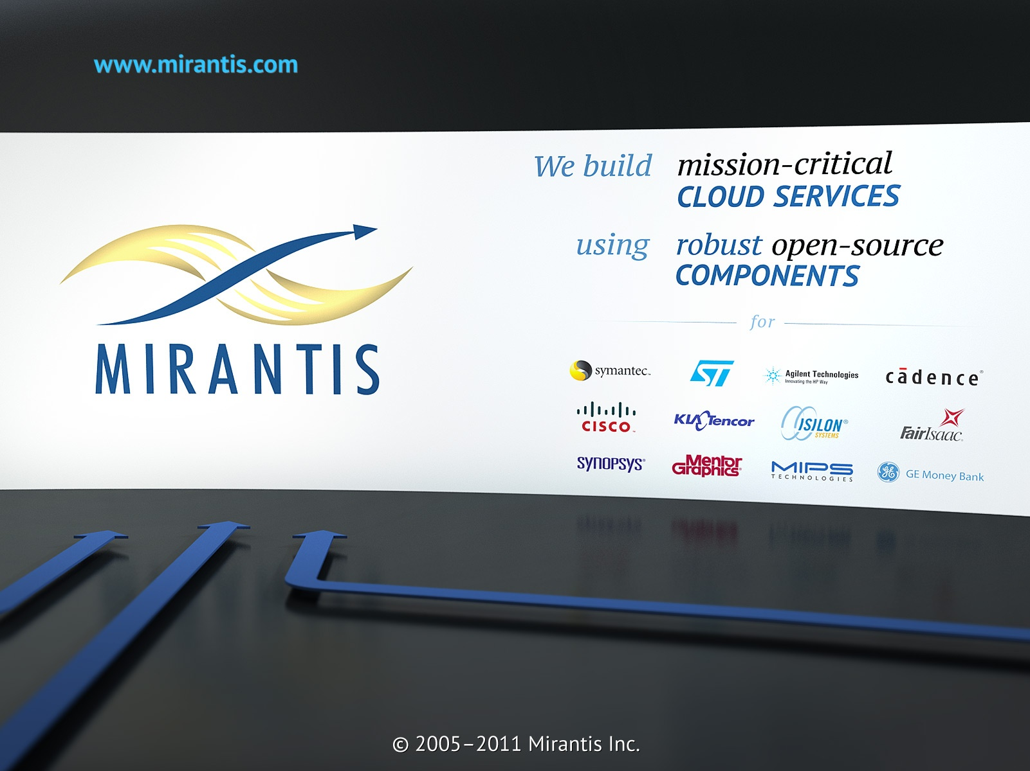
GemFire: In-Memory Data Grid
September 8th, 2011
Notes:
1

Slide 2


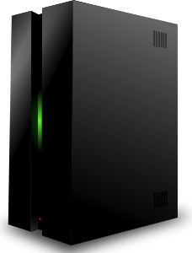

Typical application
Client
Application Tier
Data Base
2
Notes:
10 years ago Internet had 479 millions users
Now 2 110 millions users
Can we still use old architecture?
Average user spend 60 hours a month online
2

Slide 3
Is it easy to scale Data Base?
New users means, more application servers and more load to database.
Clients
Application Tier
Data Base
3
Notes:
Data Bases has:
Relational model
Strong consistency
Full transaction support
What's Wrong with Data Base?
Data is not more structured
Scaling is hard
Costs are huge
3

Slide 4
Moore's law: The number of transistors doubles approximately every 24 months
What about data?
90% of today’s data
were created in the last 2 years
Web logs, financial transactions, medical records, etc
4
Notes:
4

Slide 5
“Hardware can give you a generic 20 percent improvement in performance, but there is only so far you can go with hardware.”
Rob Wallos,
Global Head of marketing data Citi
5
Notes:
How long you are ready to wait page load?
2001 year - 8 second rule
Now less when 1 second
5

Slide 6

What is latency?
Latency – is the amount of time that it takes to get information from one designated point to another.
6
Notes:
6

Slide 7
Why worry about it?
Amazon - every 100ms of latency cost them 1% in sales
Google - an extra 0.5 seconds in search page generation time dropped traffic by 20%
Financial - If a broker's electronic trading platform is 5ms behind the competition it could loose them at least 1% of the flow - that's 4$ million in revenues per ms.
7
Notes:
7

Slide 8
How to make data access even fast?
Distributed Architecture
Drop ACID
Atomicity
Consistency
Isolation
Durability
Simplify Contract
Drop Disk
8
Notes:
8

Slide 9
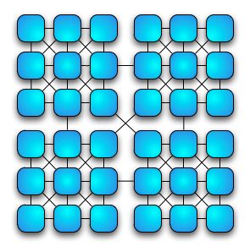
Data Grid
Data Grid is the combination of computers what works together to manage information and reach a common goal in a distributed environment.
9
Notes:
9

Slide 10
Shared nothing architecture
Is a distributed computing architecture in which each node is independent and self-sufficient, and there is no single point of contention across the system.
Popularized by BigTable and NoSQL
Massive storage potential
Massive scalability of processing
10
Notes:
There is no single bottleneck to slow the system down.
10

Slide 11
In-Memory Data Grid
Data are stored in memory, always available and consistent.
Low Latency
Linear Scalability
No Single Point of failure
Associate arrays
Replicated
Partitioned
11
Notes:
11

Slide 12

GemFire
The GemFire is in-memory distributed data management platform that pools memory across multiple processes to manage application objects and behavior.
Caching
Querying
Transactions
Event Notification
Function Invocation
12
Notes:
12

Slide 13
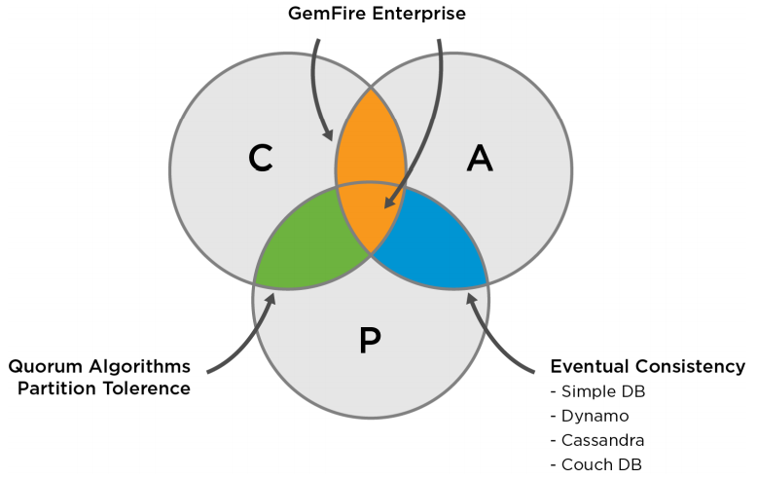
CAP Theorem
Only two of these three desirable properties in distributed system can be achieved:
Consistent
Available
Partition-Tolerant
13
Notes:
Building distributed systems, design trade-offs must be made.
13

Slide 14
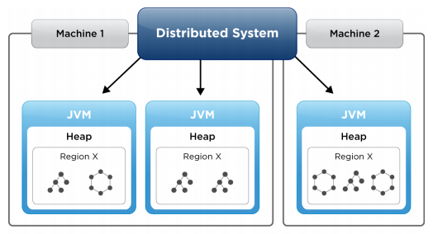
Regions
Data region is a logical grouping within a cache for a single data set.
A region lets you store data in many VMs in the system without regard to which peer the data is stored on. Work similar to Map interface.
14
Notes:
14

Slide 15
Region Example
Cache cache = new CacheFactory().set("cache-xml-file", "cache.xml”).create();
CacheServer cacheServer = cache.addCacheServer();
cacheServer.start();
Region people = cache.getRegion(”people");
people.put(“John”, john);
<cache>
<region name="people">
</region>
</cache>
Create Cache Server
Get “people” region
Place an John entry into the region
15
Notes:
15

Slide 16
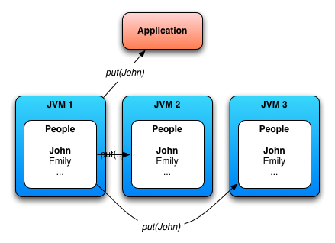
Replicated Region
Each replicated region holds the complete data set for the region
High Read Performance
Limited by JVM heap size
Used for meta data
16
Notes:
Building distributed systems, design trade-offs must be made.
16

Slide 17
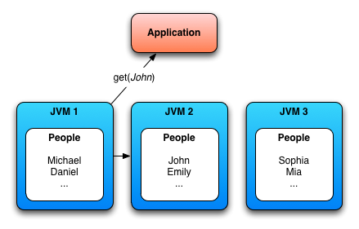
Partitioned Region
GemFire partitions your data so that each peer only stores a part of the region contents.
Data spread across nodes
Members have access to all data
Used for Large data set
Good Write Performance
17
Notes:
Building distributed systems, design trade-offs must be made.
17

Slide 18
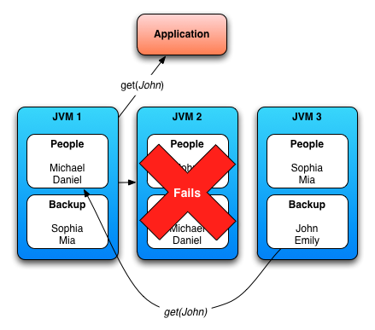
What happens if one node fails?
Recovering redundancy can be configured to take place immediately after one node fail.
This gives High Availability for partition regions.
18
Notes:
Building distributed systems, design trade-offs must be made.
18

Slide 19
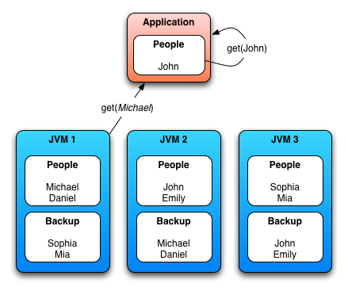
Local Region
The local region has no peer-to-peer distribution activity.
Client regions automatically defined as local regions:
Direct to distributed system
Caching Enabled
19
Notes:
Building distributed systems, design trade-offs must be made.
19

Slide 20

Peer Discovery
To connect to distributed system the peer should introduce themself:
Multicast based discovery
Locator separate component that maintains a discovery
20
Notes:
As an alternative to locators, members can use a multicast channel to find the membership coordinator and join the distributed system. Multicast is not enabled in all networks, particularly small, home-based networks.
Locator: This is a component that maintains a discovery set of all peer members in the distributed system at any given moment. Though typically started as a separate process (with redundancy), locators can also be embedded in any peer cache (like a CacheServer). New members contact the locator via a TCP port to get the current set of peer members. These members are then asked who the current membership coordinator is. Locators are neither a bottleneck to cache operations nor a single point of failure.
20

Slide 21
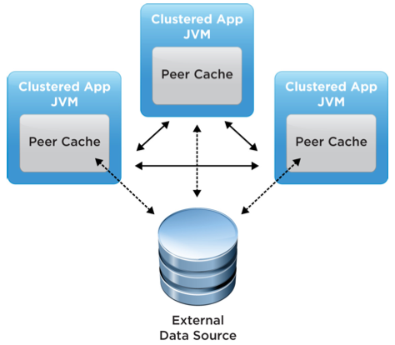
P2P topology
The cache is embedded within the application process and shares the heap space with the application.
21
Notes:
Building distributed systems, design trade-offs must be made.
21

Slide 22
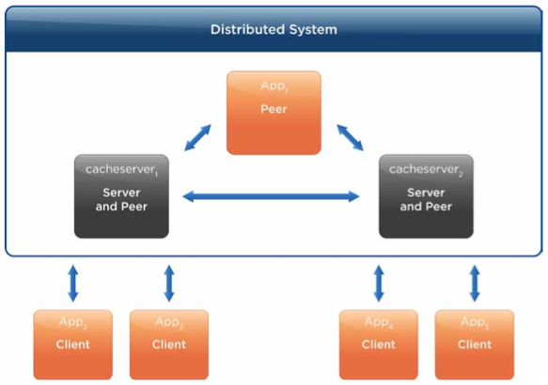
Client/Server topology
A central cache is managed in one distributed system tier by a number of server members. Clients maintain their own caches that automatically call upon the server side.
22
Notes:
Building distributed systems, design trade-offs must be made.
22

Slide 23
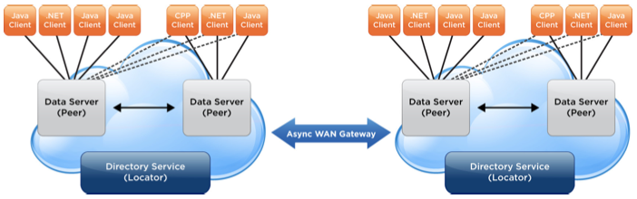
Multi-Site Caching
Distributed systems at different sites are loosely coupled through gateway system members.
23
Notes:
Building distributed systems, design trade-offs must be made.
23

Slide 24
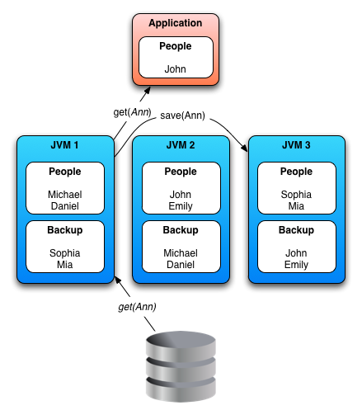
Read Through
When an entry is requested that is unavailable in the region, a Cache Loader may be called upon to load it from data source.
Operation always managed by the partition node.
24
Notes:
Building distributed systems, design trade-offs must be made.
24

Slide 25
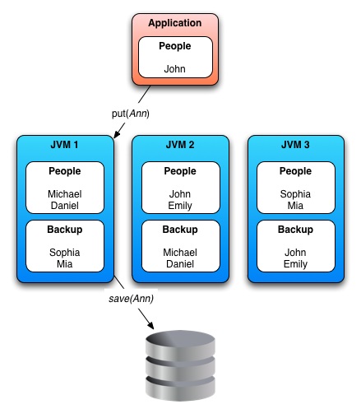
Write Through
To provide write-through caching with your external data source use CacheWriter.
Only one writer is invoked for any event.
25
Notes:
Building distributed systems, design trade-offs must be made.
25

Slide 26
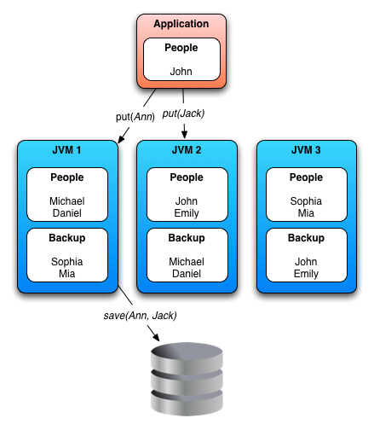
Write Behind
In the Write-Behind mode, updated cache entries are asynchronously written to the back-end data source.
26
Notes:
Building distributed systems, design trade-offs must be made.
26

Slide 27
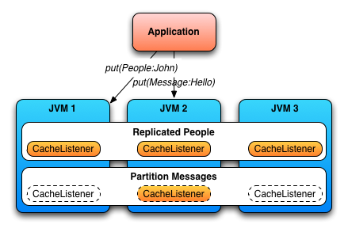
Event Listener
The cache event listeners allow you to receive after-event notification of changes to the region and its entries.
Handle following entity events:
Create
Update
Destroy
Invalidate
Executed in all
replicated regions
Executed only in one
partition region
27
Notes:
27

Slide 28
Listener Example
<region name=“people” refid=“PARTITION”>
<region-attributes>
<cache-listener>
<class-name>com.mirantis.PeopleCacheListener</class-name>
</cache-listener>
<cache-loader>
<class-name>com.mirantis.PeopleCacheLoader</class-name>
</cache-loader>
</region-attributes>
</region>
public class PeopleCacheListener<K,V> extends CacheListenerAdapter<K,V>
implements Declarable {
public void afterCreate(EntryEvent<K,V> e) {
System.out.println(e.getKey() + “ connected”);
}
public void afterDestroy(EntryEvent<K,V> e) {
System.out.println(e.getKey() + “ left”);
}
…
}
28
Notes:
28

Slide 29
Querying
Object Query Language (OQL) is SQL like query language standard for object-oriented databases.
Support normal query and continuous querying (CQ).
SELECT DISTINCT * FROM /portfolios
WHERE status = 'active' AND type = ‘XYZ’
Query query = qryService.newQuery(queryString);
SelectResults results = (SelectResults)query.execute();
for (Iterator iter = results.iterator(); iter.hasNext(); ) {
Portfolio activeXYZPortfolio = (Portfolio) iter.next();
...
}
You can also use indexing to optimize your query performance.
29
Notes:
29

Slide 30
Continuous Querying
Continuous Querying (CQ) gives your clients a way to run queries against events.
public class TradeEventListener implements CqListener {
public void onEvent(CqEvent cqEvent) {
…
}
public void onError(CqEvent cqEvent) {
// handle the error
}
public void close() {
// close the output screen for the trades ...
}
}
CqAttributesFactory cqf = new CqAttributesFactory();
cqf.addCqListener(tradeEventListener);
CqAttributes cqa = cqf.create();
CqQuery priceTracker = queryService.newCq(“tracker“, queryStr, cqa);
priceTracker.execute();
30
Notes:
30

Slide 31
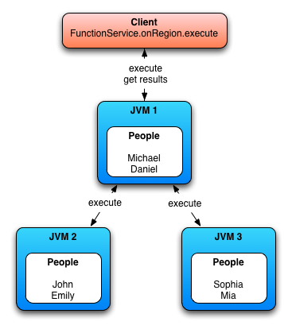
Function Execution
Application functions can be executed on:
Members
Data set
Similar to Map-Reduce
31
Notes:
31

Slide 32
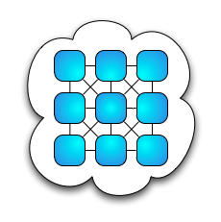
You can move the state or behavior
Clients
Application Tier
IMDG
Data Base
32
Notes:
Building distributed systems, design trade-offs must be made.
32

Slide 33
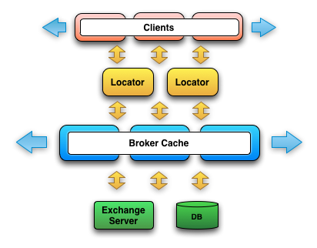
Example Broker Application
High Available
Parallel Aggregation
Exchange Server could have only one connection
Orders are swapped to Data Base
Scale on Demand
33
Notes:
Building distributed systems, design trade-offs must be made.
33

Slide 34
Learn more
VMWare GemFire http://www.vmware.com/products/vfabric-gemfire/overview.html
Monitoring Tools
GemFire Community http://community.gemstone.com/display/gemfire
Hibernate L2 Cache
Session Caching
34
Notes:
34

Slide 35
Questions and Answers
35
Notes:
35

